Slide 1
Pre-Proposal Conference

Slide 2
Department of Youth and Community Development
Our Mission
The New York City Department of Youth and Community Development (DYCD) invests in a network of community-based organizations and programs to alleviate the effects of poverty and provide opportunities for New Yorkers and communities to flourish.
Our Vision
DYCD strives to improve the quality of life of New Yorkers by collaborating with local organizations and investing in the talents and assets of communities to help them, develop, grow and thrive.

Slide 3
Agenda
Welcome and Timeline
Anticipated Total Funding and Price Per Participant
Proposal Expectations and Instructions
Pre-Qualification and Proposal Submission
Program Background and Expectations
Post Award Requirements
Question and Answer Session

Slide 4
RFP Timeline
Proposal Due Date: July 10, 2018 at 2pm
Anticipated Award Announcement Date: Late Fall 2018
Anticipated Contract Term: July 1, 2019 – June 30, 2023 (with an Option to Renew for up to an additional 2 years)
Questions regarding RFP: RFPquestions@dycd.nyc.gov (Must be received by July 2, 2018)

Slide 5
Anticipated Total Funding Price Per Participant
COMPASS Elementary
Full Contract Term Total Funding: $231,822,428
Price Per Participant: $3,516
COMPASS Middle School
Full Contract Term Total Funding: $130,730,936
Price Per Participant: $3,792

Slide 6
Proposal Expectations and Instructions
Required Documents
Proposal
Community Partnerships
Signed School Partnership Agreement
Organizational Chart
Job Descriptions or Resumes (if available) for Key Staff positions
Budget
Doing Business Data Form
Summer Activity Schedule
School Year Activity Schedule
Evaluation Criteria
Organizational Experience (20 points)
Program Approach (10 Points)
Community Partnerships (10 Points)
Program Design (30 points)
Staffing (25 Points)
Budget Management (5 points)

Slide 7
HHS Accelerator

Slide 8
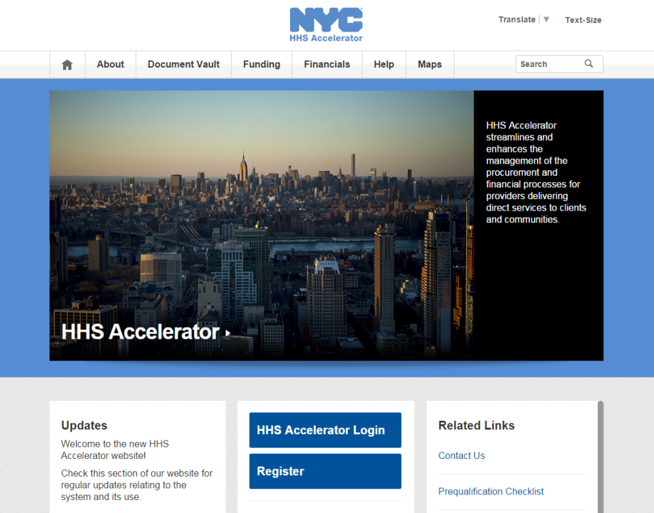
PROPOSING IN HHS ACCELERATOR
The HHS Accelerator System was launched to simplify and improve the competitive contract process for Health and Human Service providers.
Agencies publish all Request for Proposals (RFP) Documents in the HHS Accelerator System.
Prequalified providers approved for relevant Services are “Eligible to Propose” and can submit proposal(s) after RFPs are released.
Providers must submit proposals through the HHS Accelerator System by the proposal due date and time (2 pm).
Need Help?
Contact: help@mocs.nyc.gov

Slide 9
Department of Education

Slide 10
DOE OFFICE OF SCHOOL PARTNERSHIPS
The Office of Community Schools supports schools to work with Community Based Organizations (CBOs) to become places where children have opportunities to learn, gain skills, create joy, and have experiences that ignite curiosity and allow children to discover their passions and talents.

Slide 11
PRINCIPLES FOR EFFECTIVE SCHOOL /CBO PARTNERSHIPS
School Partnership Agreement (SPA) is a minimum requirement for the RFP. Meetings with principals can be conducted between May 21st to July 3rd.
Principals will need to sign off on a School Partnership Agreement (SPA) and proposals will not be considered without the principal’s signature. Principals have the option of signing multiple SPAs – each of the proposals will be considered. The proposal with the highest score will be awarded a COMPASS contract.

Slide 12
PRINCIPLES FOR EFFECTIVE SCHOOL /CBO PARTNERSHIPS CONTINUED
After the “interview,” principals must complete a simple summary of the meeting in the required Google form indicating whether or not they signed a School Partnership Agreement (SPA)—and if not, why.

Slide 13
PRINCIPLES FOR EFFECTIVE SCHOOL /CBO PARTNERSHIPS
The Office of Community Schools has worked with DYCD to prioritize and strengthen relationships between schools and CBO partners – for instance, the host school Principal and CBO leadership will be expected to work collaboratively in defining and establishing COMPASS Program Director’s expectations including but not limited to being part of the hiring process. Additional items include but are not limited to:
Principal identifying a liaison from his/her staff to facilitate ongoing communication.
COMPASS Program Director being part of school governance structure.
Establishing regularly scheduled meetings with the Principal or designee.
Identifying space, classrooms, and resources.

Slide 14
PRINCIPLES FOR EFFECTIVE SCHOOL /CBO PARTNERSHIPS
PLANNING
Plan collaboratively from the start
Gather key stakeholders (parents, community members, school leadership team, participants, etc.) to develop and clarify the program vision
Participate in the selection of key program staff such as the Program Director & Education Specialist
Clarify roles and responsibilities of both school and CBO staff
PROGRAMMING
Set ground rules
Start small and build gradually
Share decision-making
Prepare team members to work together
Make adjustments to the program as needed and keep lines of communication open with all stakeholders

Slide 15
COMPREHENSIVE AFTER SCHOOL SYSTEM OF NYC (COMPASS) helps young people build knowledge, skills and self-confidence and nurtures their aspirations through a variety of high quality enrichment opportunities.
In partnership with community-based organizations through funding, capacity building, evaluation and advocacy, COMPASS strives to enhance and expand a sustainable network of out of school time programs for youth, families and communities.

Slide 16
Overview
DYCD is seeking qualified non-profit organizations to operate year-round COMPASS elementary and middle school after school programs, serving students in grades K-5, and 6-8 public and charter schools.
COMPASS Elementary school programs that promote positive youth development, encourage youth leadership, foster social and emotional skills, and support the expansion of knowledge and mastery of skills.
COMPASS Middle school programs that encourage youth to experience the joy of learning outside the classroom while fostering social, emotional and cognitive skills, with activity options that allow for youth voice and choice.

Slide 17
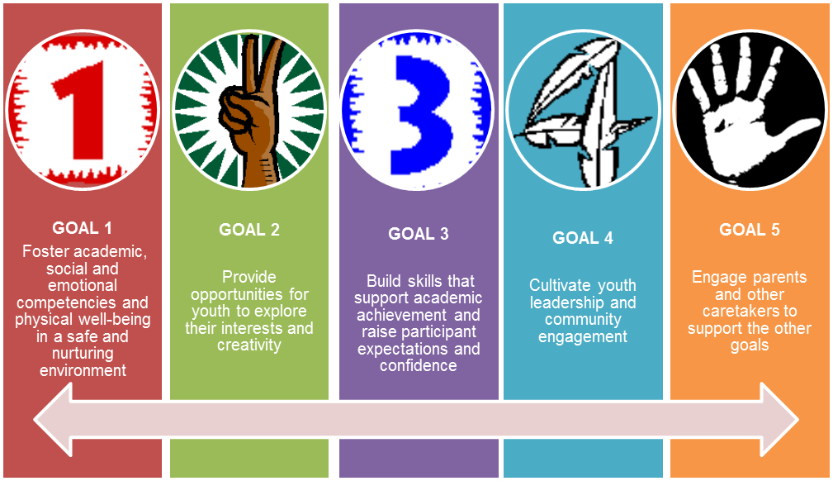
Goals

Slide 18
Program Expectations:
Program Approach (Program Philosophy)
Assets-based approach
Circles of Support/Family Engagement
Community Partnerships
Minimum of 3 partnerships with an external organization/group (arrangements with another unit/division of a multi-service organization do not count)
Focus on Positive Youth Development (PYD), Social and Emotional Learning (SEL), and Youth Leadership
Enhance program for benefit of participants and help foster effective provider networks at local level
Organizational Experience
Three years of successful experience, within the last five years, providing comprehensive afterschool services

Slide 19
Program Design: Expectations
Target Population
Serve students in grades K-5 (Elementary), 6-8 (Middle)
English Language Learners
Recruit and tailor their program designs to meet the needs of a wide range of participants:
Readiness to Begin Operations
Ready to provide the required summer and school year program components throughout the contract period on the established start dates with cleared staff.
Students who identify as lesbian, gay, bisexual, transgender, queer and questioning (LGBTQ)
Students with special needs
Children in foster care
Children living in homeless shelters

Slide 20
Elementary School Required Hours
SERVICE DAYS | OPERATING HOURS | TOTAL OPERATING HOURS
Monday - Friday (3 hours per day) | 540 hours during school year (15 hours per week X 36 weeks) 130 school holiday hours (10 hours X 13 holidays) 350 hours during the summer (50 hours X 7 weeks) | 1,020
350 hours over a period of 7 weeks: 10 hours per day, Monday to Friday, 8 a.m. to 6 p.m.
540 hours: at least 3 hours per day after school, Monday to Friday.
Summer
36 weeks of the school year
(September 1 to June 30)
1,020 hours
annually
School Year
130 hours during school closing days: 10 hours per day, 8 a.m. to 6 p.m., on 13 school closing days.
REQUIRED PROGRAM MODEL COMPONENTS (School Year & Summer)
Homework Help/Academic support
(2) Hours per week of STEM or Literacy-focused enrichment activities scheduled for at least 1 semester at a time
90 minutes of physical activity per week per participant
Target enrollment: Kindergarten -5th grade students

Slide 21
Program Design: Elementary Program Activities
1
2
3
Academic Support
Enrichment
Physical Activity
Notes:
Academic Support: Academic support should include homework help, individual or small group tutoring, book clubs, and guided independent reading which (that) aim to strengthen basic reading, writing and math skills.
Enrichment: Offers at least two hours per week of STEM -or- literacy-focused activities throughout the program year. Activities should offer programming that is consistent and theme-based, scheduled for at least one semester at a time, and guided by a curriculum or well-designed lesson plans. Project-based activities that embed literacy or STEM skills are preferred but not required.
Physical Activity: The activity schedule must provide a minimum of 90 minutes of physical activity per participant, per week during the program year. This could include gym/physical education, organized sports, dance, martial arts, yoga, and other forms of organized and supervised physical exercise and recreation.

Slide 22
Program Design: Elementary Optional Content Areas
4
5
6
Arts-focused Enrichment Activities
Leadership Activities
Healthy Living
Notes:
Arts-focused Enrichment Activities: The goal of arts-focused activities may be the development of artistic literacy and mastery of skills in a particular discipline (e.g., dance, media arts, music, visual arts, theater, etc.), and can be designed to include problem solving, teamwork, creativity and self-expression.
Leadership Activities: A wide range of activities provide opportunities for children to take responsibility, lead, and develop leadership skills. Examples include the ability to articulate personal values, awareness of how personal actions impact peers and the wider community; awareness of and appreciation of cultural differences among peers and within the larger community.
Healthy Living: In addition to the required minimum of 90 minutes of physical activity per week for every participant, DYCD encourages programs to include active learning sessions designed to teach the relationship between physical activity, good nutrition, and healthy life-styles and practices.

Slide 23
Middle School Required Hours
MINIMUM SERVICE DAYS | OPERATING HOURS | TOTAL OPERATING HOURS
Monday - Friday 15 hrs./ week ( 9hrs. must be structured) operate 1.5 hrs./day 36 Weeks September 1st – June 30th | School Year: Minimum of 324 structured hours (36 Weeks: September - June) Summer: 108 hours of programming (over a minimum of four weeks) | 648 540 school year hours 108 summer hours
540 hours: at least 3 hours per day after school, Monday to Friday.
REQUIRED PROGRAM MODEL COMPONENTS (School Year & Summer)
The school year schedule must include a minimum of (2) hours per week of structured Literacy or STEM and (2) hours of structured Leadership Development, Structured Academic Support and Physical /Healthy living activities.
The summer schedule must include at least (2) hours per week of either STEM or Literacy, at least (2) hours of Leadership Development and Physical /Healthy Living activities.
130 hours during school closing days: 10 hours per day, 8 a.m. to 6 p.m., on 13 school closing days.
Notes:
*Structured activities have clearly defined goals or skill gains, organized sequentially in accordance with lesson plans or a curriculum and clear instructional strategies

Slide 24
Program Design: Middle School Required Content Areas
1
2
3
4
Academic Support
Enrichment
Physical Activity/
Healthy Living
Leadership Development
Notes:
Academic Support: These services could include homework help, individual or small group tutoring, book clubs and guided independent reading. Preferably, priorities for academic support should be discussed with the school principal and referenced in the School Partnership Agreement.
Enrichment: Programs are required to offer at least 2 hours per week of structured literacy or STEM enrichment activities. Activities may include arts-focused or other activities in addition to or as part of their programming in literacy or STEM. All enrichment activities should be designed to support development of teamwork, problem solving, critical thinking and basic academic skills.
Physical Activity/Healthy Living: Physical activities might include sports, martial arts, dance, and other forms of physical exercise. Include opportunities for physical activity in their program designs. Healthy living could comprise programming that involves active learning designed to help students understand the importance of healthy lifestyles, including physical activity and good nutrition.
Leadership Development: Programs must offer participants at least 2 hours per week of structured Leadership Development activities. Foster engagement in school and community. Build skills that encompass a range of critical competencies that help youth make informed choices about their futures and encourage socially responsible behaviors.

Slide 25
Staffing: Roles, Qualifications and Experience
Would have, at least, a relevant Bachelor’s degree, minimum of 3 years of experience in a supervisory position, and be responsible for program operations and supervision.
Program Director
Provides onsite observation, evaluates activities weekly while providing feedback; reviews lesson plans and ensures activities are designed with learning goals or skill gains; adapts curricula to fit program goals.
Education Specialist
Leads program activities in areas that require specific expertise and experience, e.g., STEM, literacy, art, dance, and organized sports.
Activity Specialists
Responsible for supervising and leading a group of program participants and creating and implementing activities.
Group Leaders

Slide 26
Staffing: Program Size Requirements
Programs with 90 or more participants:
The position of Program Director must be full-time (i.e., at least 35 hours per week).
The position of Education Specialist may be part-time on the condition he/she provides at least 9 hours of support per week to the program for a maximum of three programs.
Programs with fewer than the 90 participants:
The position of Program Director may be part-time (i.e., less than 35 hours per week), He/she must be present during all program operational hours for a minimum of five days per week.
The Program Director, whether full-time or part-time, cannot be the Education Specialist.

Slide 27
Performance Targets
Full enrollment for the school year by mid-October in each contract year and maintain 100 percent enrollment throughout the school year period for the duration of the contract.
Elementary
Achieve a minimum Rate of Participation (ROP) of 80 percent.
Middle
Achieve a minimum of 75% of the 324 structured hours.

Slide 28
Summary of Addendum Items
Elementary School Changes:
Add P.S. 91K to Elementary Eligible Schools List
Include required activities and weekly hours for summer programming
2 hours of STEM or Literacy
Academic Support
90 minutes of Physical Activity per participant
Middle School Changes
Remove School for Human Rights from the Middle School Eligible Schools List
Add Offsite Activity language
Add the word structured to language for summer required activities.
Programs are expected to operate a minimum of 15 hours a week, of which a minimum of 9 hours are structured, and programs are offered for a minimum of 1.5 hours each weekday.

Slide 29
Post Award Requirements
Public Assistance Hiring Commitment Rider
The Public Assistance Hiring Commitment is an initiative administered by the Human Resources Administration (“HRA”) through its Business Link program the FAQ regarding this requirement has been provided to you at the sign in table.
Notice for Proposer Subcontractor Compliance
Please be advised there is a requirement to utilize the Payee Information Portal (PIP) to identify all subcontractors and to enter all subcontractor payment information and other related information during the contract term.

Slide 30
Post Award Requirements
Responsibility Determination
Please be advised that it is a requirement for all contractors to be determined responsible in the Post Award phase. Therefore, please make sure your Charities filings are current and ensure that any outstanding liens or adverse information has been resolved. Unresolved issues often cause significant delays in the post award process.
NYC Liability Insurance Requirement
Commercial General Liability
Motor Vehicle Liability (if applicable)
Workers’ compensation
An original certificate of insurance naming the City of New York, together with its officials and employees, as an additional insured.
DYCD will not be able to proceed with processing an awarded contract until it has obtained proof of the necessary insurance coverage.

Slide 31
Important Information
MWBE Participation
DYCD encourages MWBE participation and recommends the utilization of certified MWBEs
Posting
Transcript, presentation and attendance rosters will be posted to DYCD website for viewing

Slide 32
Question and Answer Session

Slide 33
THANK YOU!

